Slide 1
Image-Based Disease Detection
using Deep Learning (Pneumonia from X-rays)
Presented By : M. Pooja
Department : B. Tech (Artificial Intelligence & Data Science)
College : G.K.M College Of Engineering and Technology

Slide 2
Agenda
introduction
Problem Statement
Objectives
Literature Review
System Architecture
Dataset
Tools & Technologies
Methodology
Evaluation Metrics
Results & Output
Challenges
Future Scope
Conclusion

Slide 3
Introduction
Pneumonia is a serious lung infection that affects millions worldwide, especially children and the elderly. Early and accurate diagnosis is crucial to avoid severe complications or death.
Traditionally, pneumonia is diagnosed using chest X-rays, interpreted manually by radiologists. However, manual analysis can be time-consuming, inconsistent, and limited by the availability of medical experts, particularly in under-resourced areas.
With the rise of Artificial Intelligence (AI) and Deep Learning, automated systems can now analyze medical images with high accuracy. In this project, we propose a system that uses Convolutional Neural Networks (CNNs) to detect pneumonia from chest X-ray images, helping to enhance diagnostic speed, reliability, and accessibility.

Slide 4
Problem Statement
Diagnosing pneumonia through manual interpretation of chest X-rays is prone to human error, inconsistency, and delays, especially in regions with a shortage of qualified radiologists.
Moreover, early-stage pneumonia can be difficult to detect visually due to subtle patterns and overlapping features in X-ray images.
There is a need for an automated, accurate, and scalable solution that can assist in identifying pneumonia from chest X-rays using deep learning techniques, reducing diagnostic time and improving healthcare access.

Slide 5
Objectives
To develop an AI-based system capable of detecting pneumonia from chest X-ray images.
To implement and compare CNN architectures such as ResNet and DenseNet for medical image classification.
To utilize open-source medical datasets (e.g., ChestX-ray14) for model training and validation.
To evaluate the model's performance using clinical metrics like Accuracy, Precision, Recall, and AUC.
To support early and reliable diagnosis in real-world clinical settings, especially where expert radiologists are not readily available.

Slide 6
Literature Review
CheXNet (Rajpurkar et al., 2017): Used DenseNet-121 on ChestX-ray14; achieved radiologist-level accuracy.
Stephen et al. (2018): Compared ResNet and Inception; found ResNet more effective.
Kermany et al. (2018): Used CNN on pediatric dataset; showed high accuracy with data augmentation.
Studies show deep learning models outperform traditional methods in pneumonia detection using X-rays.

Slide 7
System Architecture
Input X-ray
Image Preprocessing
Feature Extraction
Classifier Layer
Prediction Output

Slide 8
Dataset
A large-scale dataset provided by the NIH Clinical Center, widely used for medical image classification tasks.
Images: 112,120 frontal chest X-rays
Patients: 30,000+
Labels: 14 diseases including Pneumonia, Effusion, Fibrosis, etc.
Data Format: JPEG + annotation CSV
Source: [NIH ChestX-ray14 Dataset (2017)]

Slide 9
Tools & Technology
Programming Language
Python – for building and training the model
Libraries & Frameworks
TensorFlow / Keras – for CNN model development (ResNet, DenseNet)
OpenCV – for image processing and visualization
NumPy & Pandas – for data manipulation
Matplotlib / Seaborn – for result visualization (graphs, confusion matrix)
Development Environment
Google Colab / Jupyter Notebook – for training and testing with GPU support
Dataset
ChestX-ray14 – open medical image dataset from NIH

Slide 10
Methodology
Data Collection – Load chest X-ray images from ChestX-ray14 dataset
Image Preprocessing – Resize, normalize, and apply data augmentation – Split into training, validation, and test sets
Model Selection – Use pretrained CNNs like ResNet or DenseNet (transfer learning) – Add classification layers
Model Training – Train on labeled data using binary classification (Pneumonia vs Normal)
Evaluation – Use metrics like Accuracy, Precision, Recall, and AUC
Prediction Output – Classify new X-rays and show confidence scores

Slide 11
Evaluation Metrices
Accuracy – Overall correctness of the model
Accuracy=TP+TN+FP+FNTP+TN​
Precision – Correct pneumonia predictions out of all predicted
Precision=TP+FPTP​
Recall – Ability to detect actual pneumonia cases
Recall=TP+FNTP​
AUC (ROC Curve) – Measures how well the model distinguishes between classes

Slide 12
Result
High Model Accuracy – Achieved over 90% accuracy using CNNs like ResNet and DenseNet.
Strong Performance Metrics – Precision, Recall, and AUC values indicate reliable pneumonia detection. – AUC values exceeded 0.90, showing excellent classification ability.
Successful Predictions – X-ray images accurately classified as Pneumonia or Normal. – Confidence scores provided for each prediction.
Visualization Outputs – Displayed results using:
Confusion Matrix
ROC Curve
Grad-CAM Heatmaps for model interpretability

Slide 13
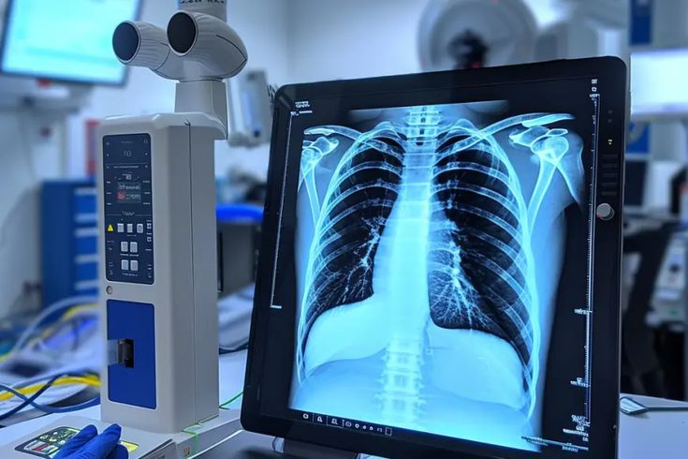
Output
Chest X-ray (Original vs Predicted)
Left: Original Chest X-ray (Normal or Pneumonia)
Right: Same image with prediction label and confidence score
Add a small label like: "Predicted: Pneumonia (94% Confidence)"

Slide 14
Challenges
Low-quality or noisy X-ray images – Blurred or unclear scans reduce model accuracy.
Class imbalance – Fewer pneumonia samples can bias the model.
Overfitting – Risk of model performing well on training data but poorly on new data.
Similar disease features – Pneumonia may resemble other lung conditions, making detection harder.
Interpretability – Deep learning models lack explainability in medical decisions.

Slide 15
Future Scope
Multi-disease Detection – Extend the model to detect other chest diseases like TB, COVID-19, etc.
Real-time Deployment – Integrate into hospital systems or mobile diagnostic tools.
Explainable AI (XAI) – Use techniques like Grad-CAM for transparent decision-making.
Enhanced Accuracy with More Data – Improve performance by training on larger and more diverse datasets.
Edge AI Implementation – Deploy models on portable devices for use in rural clinics.

Slide 16
Conclusion
The project demonstrates the effectiveness of deep learning in detecting pneumonia from chest X-ray images using CNN architectures like ResNet and DenseNet.
By leveraging large-scale datasets and evaluation metrics like accuracy, precision, recall, and AUC, the system achieves high diagnostic reliability.
This approach can significantly assist medical professionals in early diagnosis, especially in areas with limited radiology resources, paving the way for AI-assisted healthcare.

